Slide 1
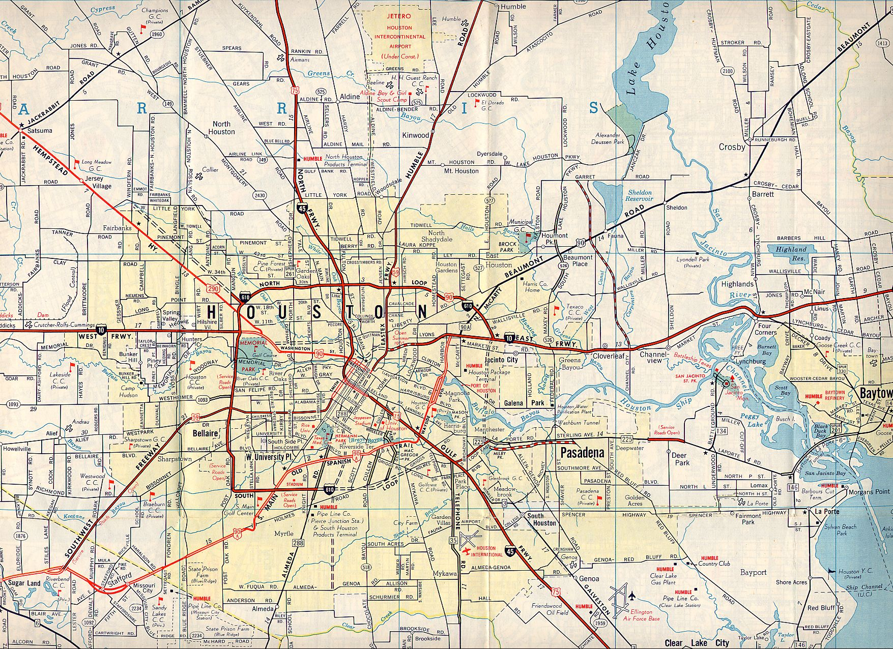
Road maps
Road maps are use to show roads. Like when someone is driving from state to state.

Slide 2
Topographic maps
Topographic map shows detailed features of the earth.

Slide 3
Aeronautical map
Aeronautical are maps for plans.

Slide 4
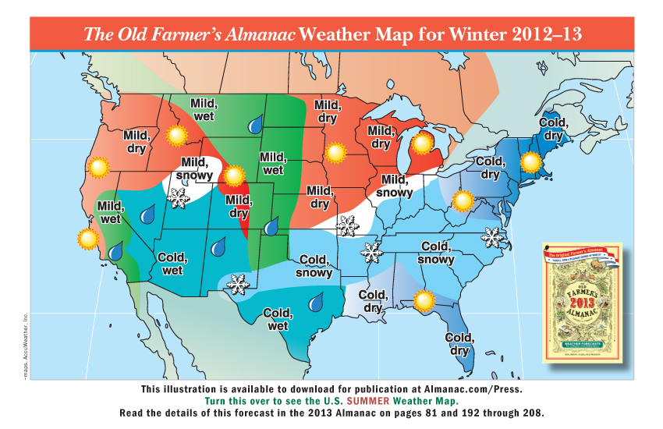
Weather maps
Weather maps are maps that show that show weather patterns .

Slide 5
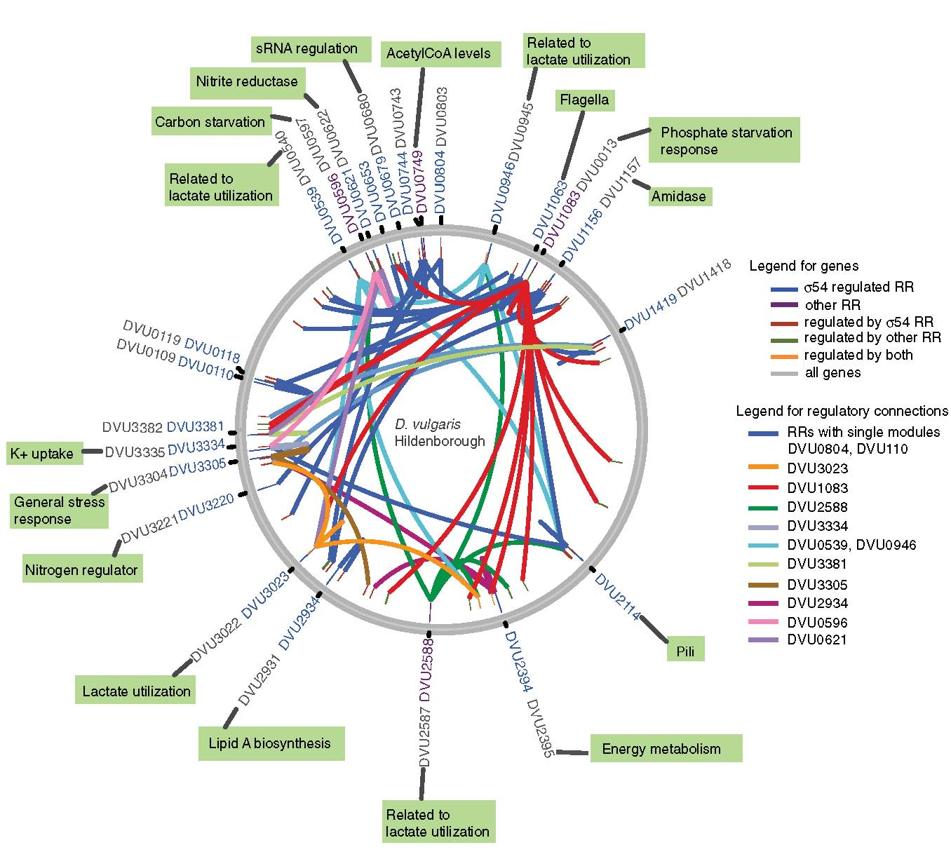
Gene maps
Gene maps show different types of dna.

Slide 6
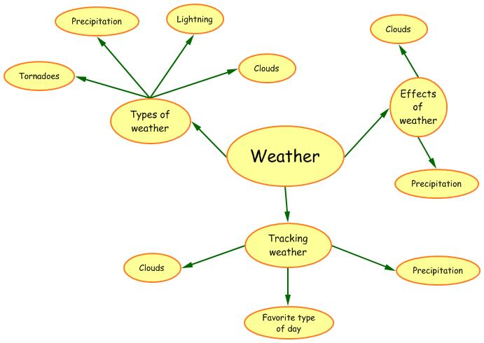
Concept map
There are all different types of concept maps like the flowchart and the systems concept maps.

Slide 7
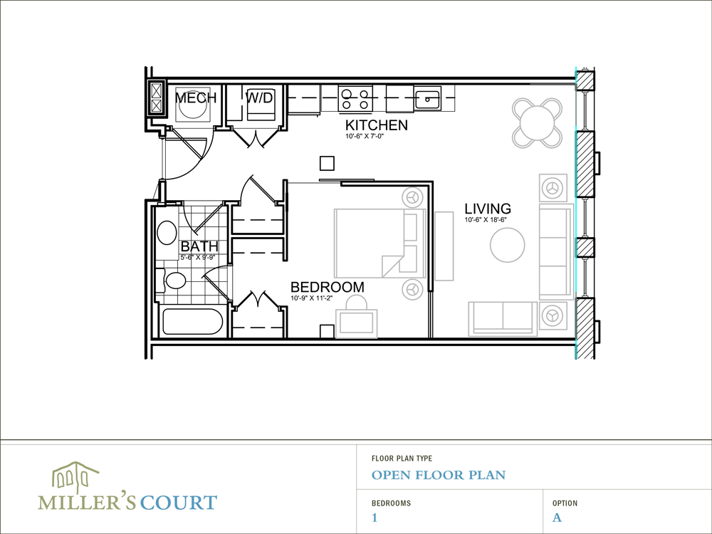
Floor plan
Floor plans are a type of map that is use to show what a house on the inside is going to look like when its done being built. Also what the size of the stuff suppose to be.

